Slide 1
Events

Slide 2
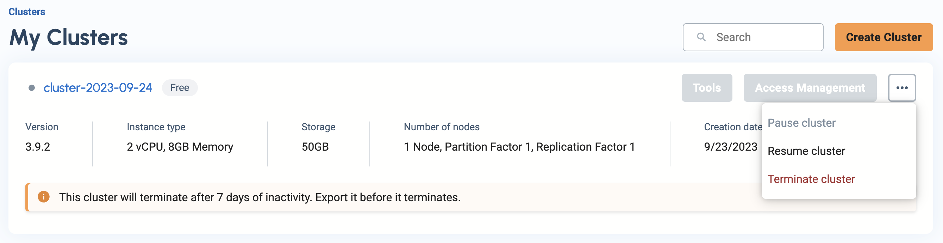
Start your TigerGraph Server
Log into tgcloud.io

Slide 3


Continue project_5
Activate Virtual Environment
Windows
Mac/Linux

Slide 4
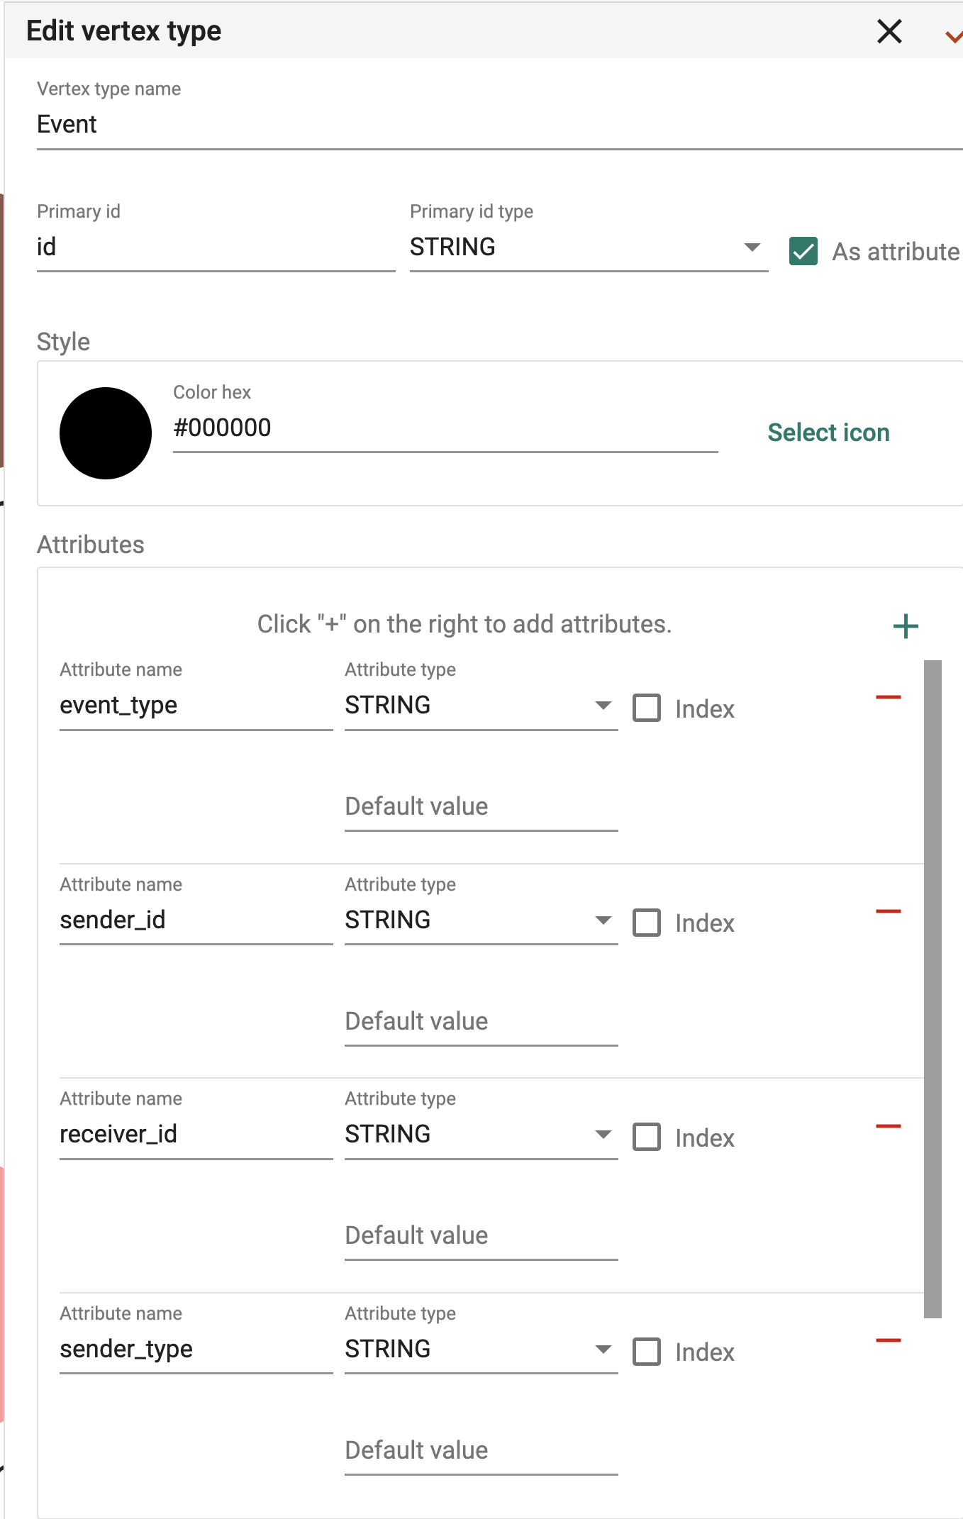
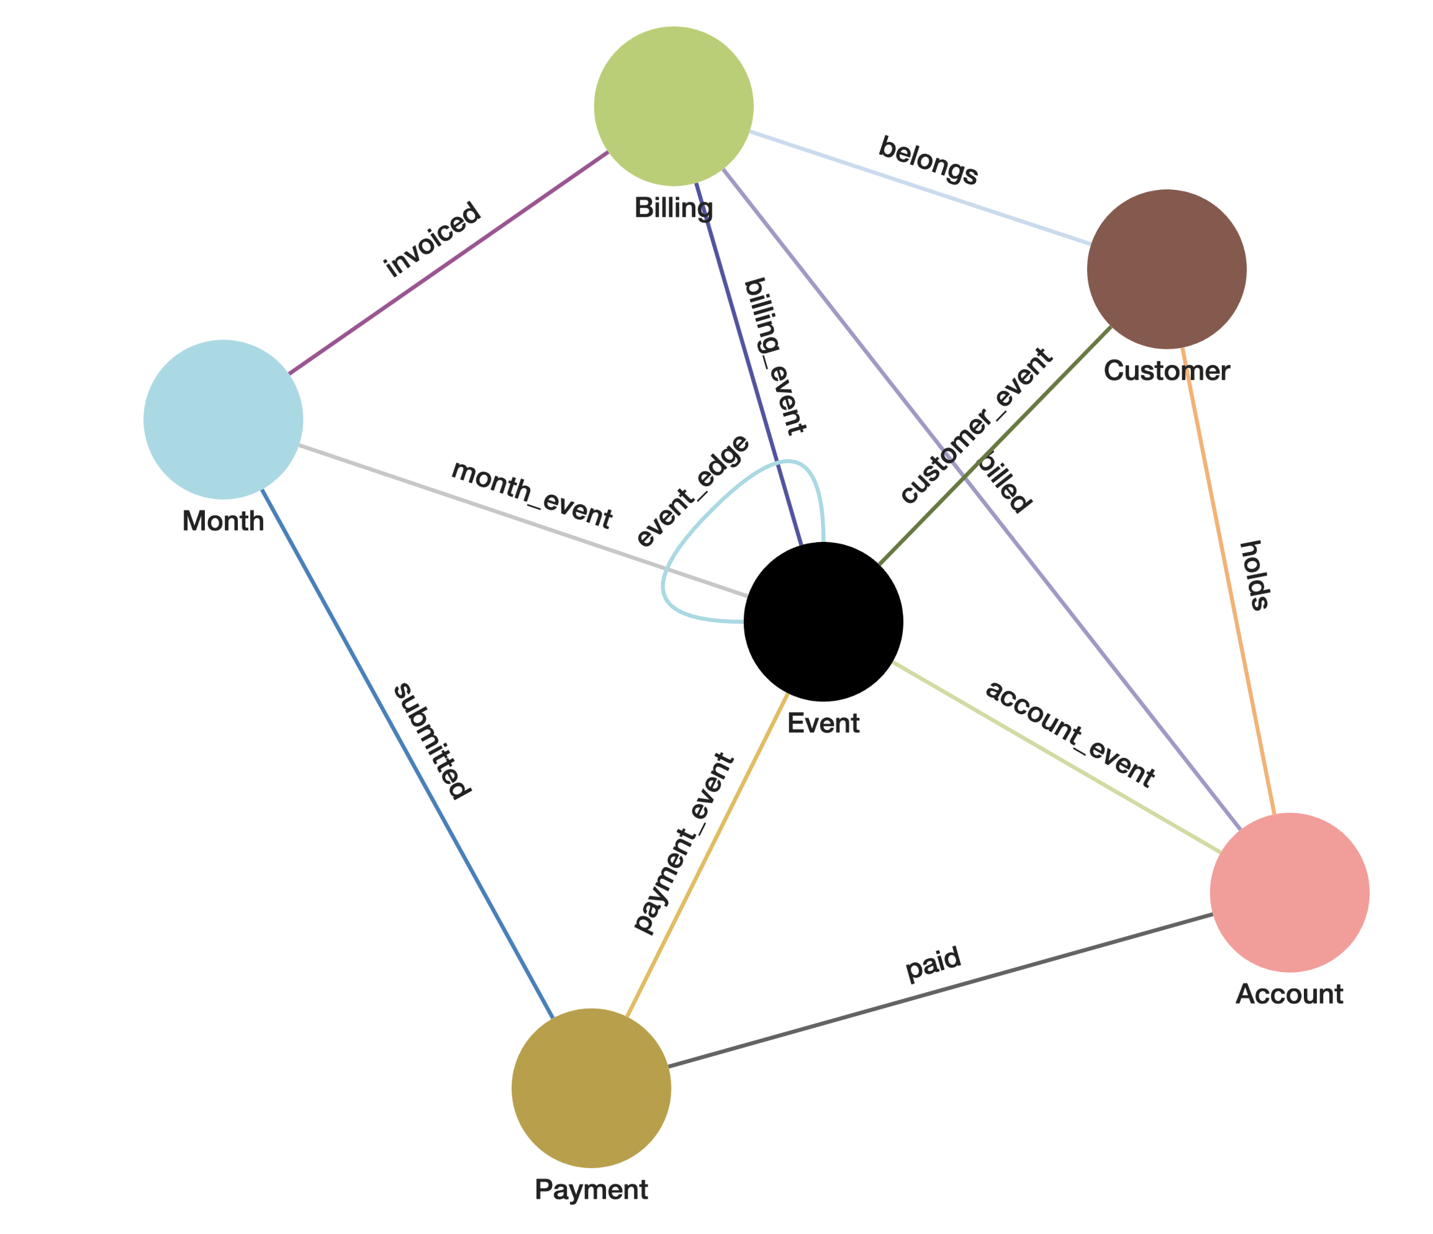
Adding Event Vertex to Schema

Slide 5
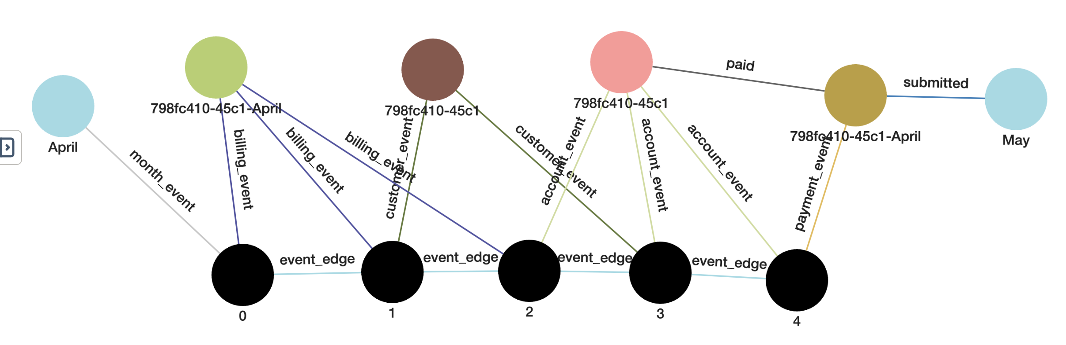
What is an Event?
An Event is any action that changes the state of the data. Any time the knowledge network in the graph changes, an event has occurred.

Slide 6
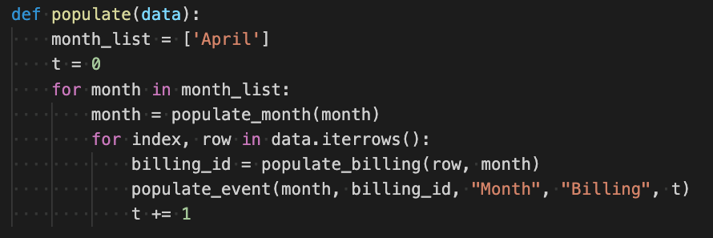
Adding Events to Months and Bills
Only Focusing on the month of April
Populate Event

Slide 7
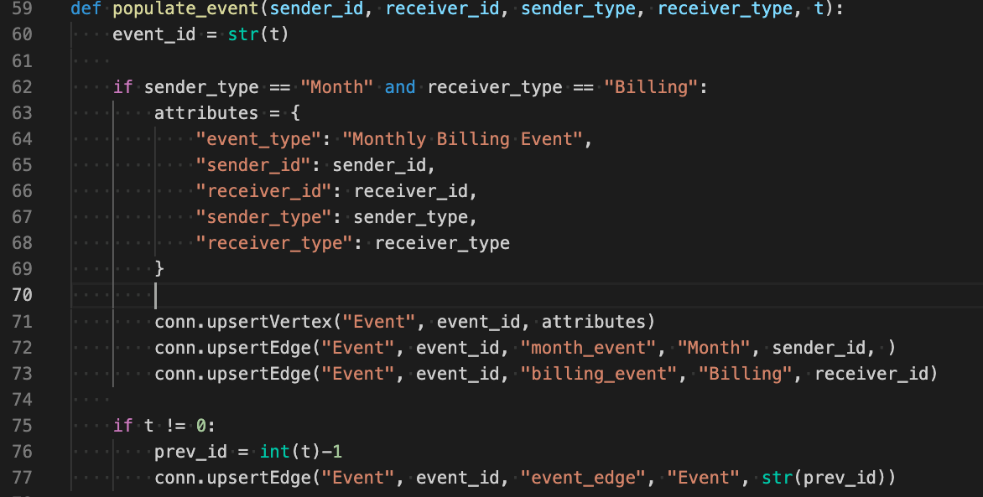
Populate_event

Slide 8
Let’s break it down
ID of the vertex
initiating the event
(month_id)
ID of the vertex
Effected by the event
(billing_id)
Vertex Type of
Sender
(month)
Vertex Type of
Receiver
(billing)
t = time

Slide 9
What is t?
t is a shorthand for time. This is a sequential representation of the advancement of the system through time.
t = 0 to represent the starting state
t = n to represent the current state

Slide 10
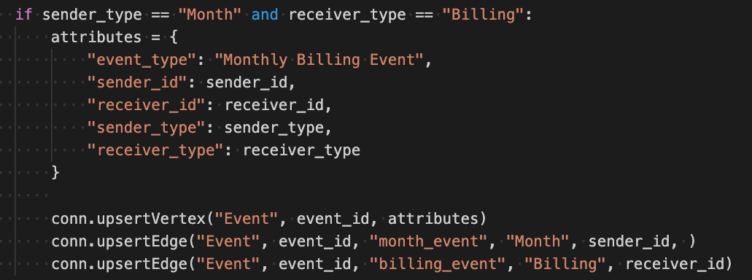
Specific Events

Slide 11
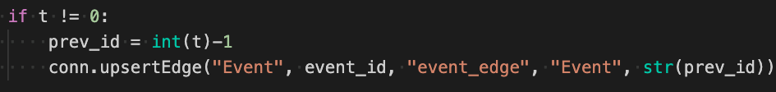
Connecting events through time

Slide 12
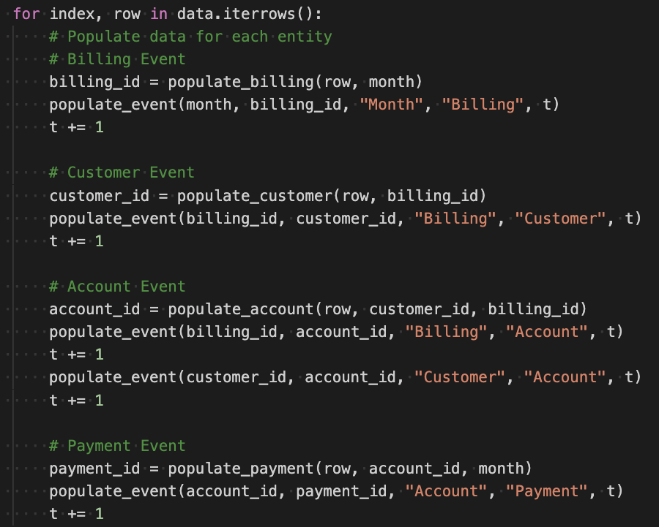
Events of all types

Slide 13
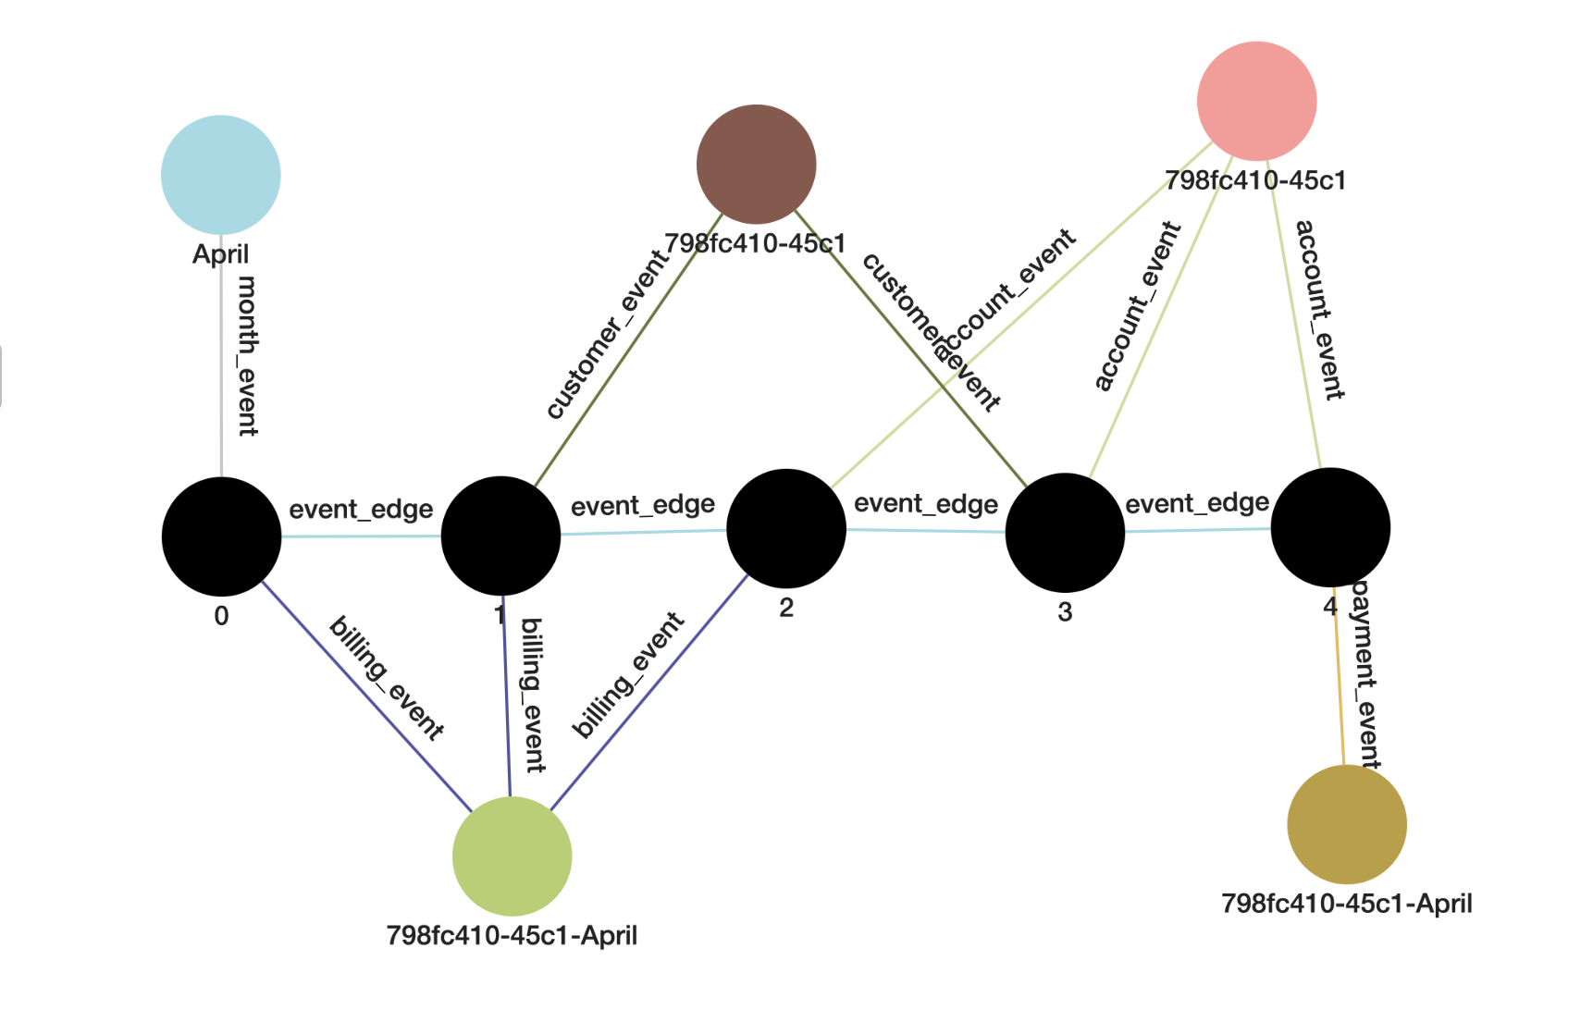
One instance of a single user through events

Slide 14
We have a Problem

Slide 15
Our data doesn’t make sense.
Let’s talk about it. Our data does not add up.

Slide 16
Let’s fix that with TigerGraph
As we upload our data sequentially through time. We can check for mistakes in our data by pulling old instances from TG to validate the new values we are applying.
To do this, we will query the data in our graph with:

Slide 17
First we need to allow access to fetch data from TigerGraph

Slide 18
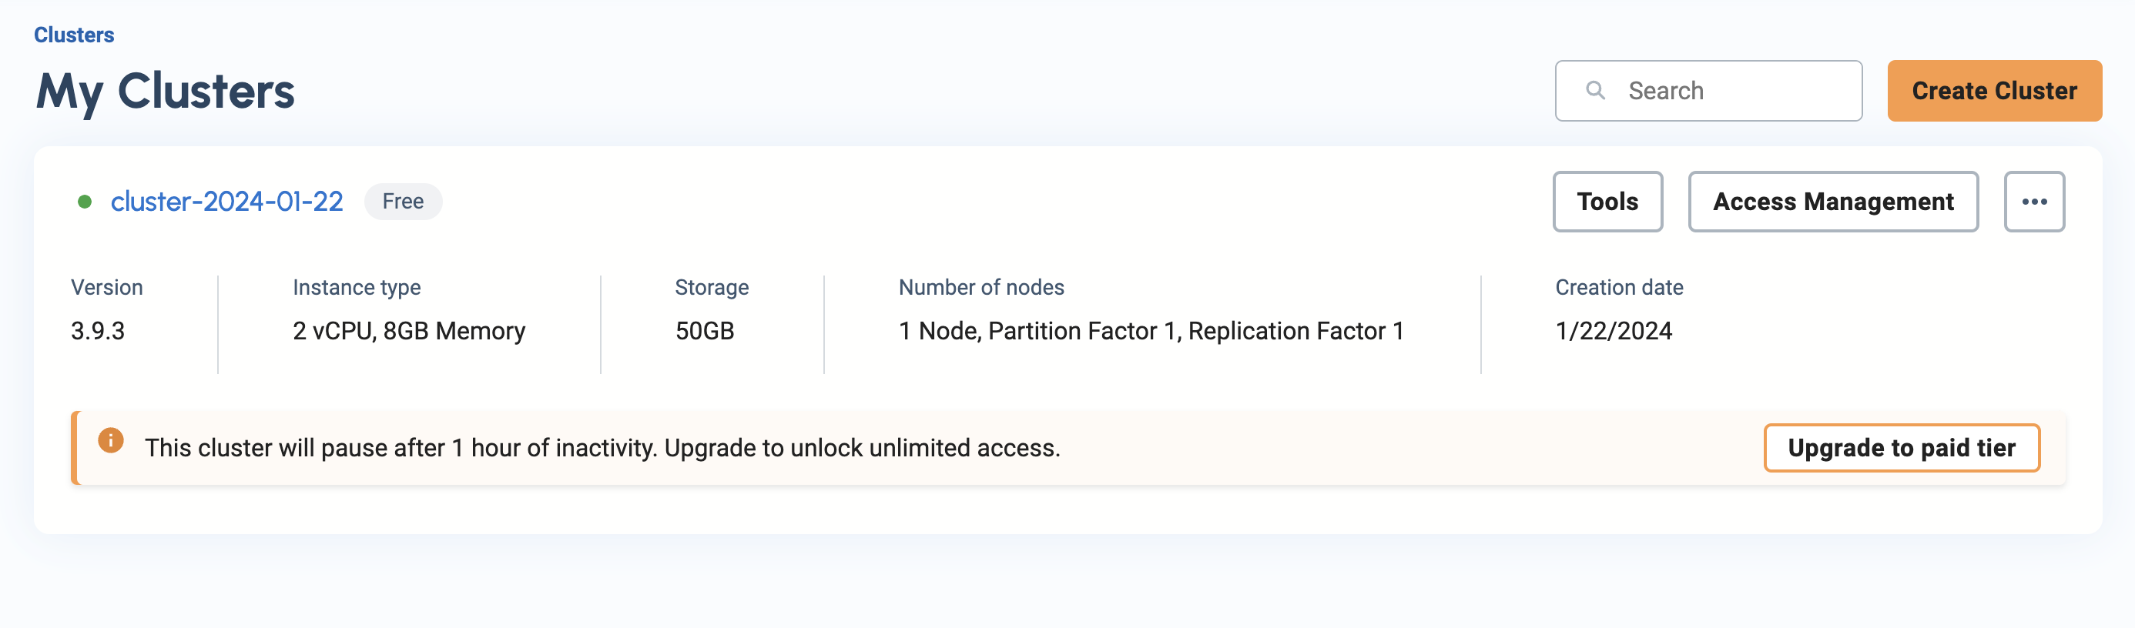
Allow user communication

Slide 19
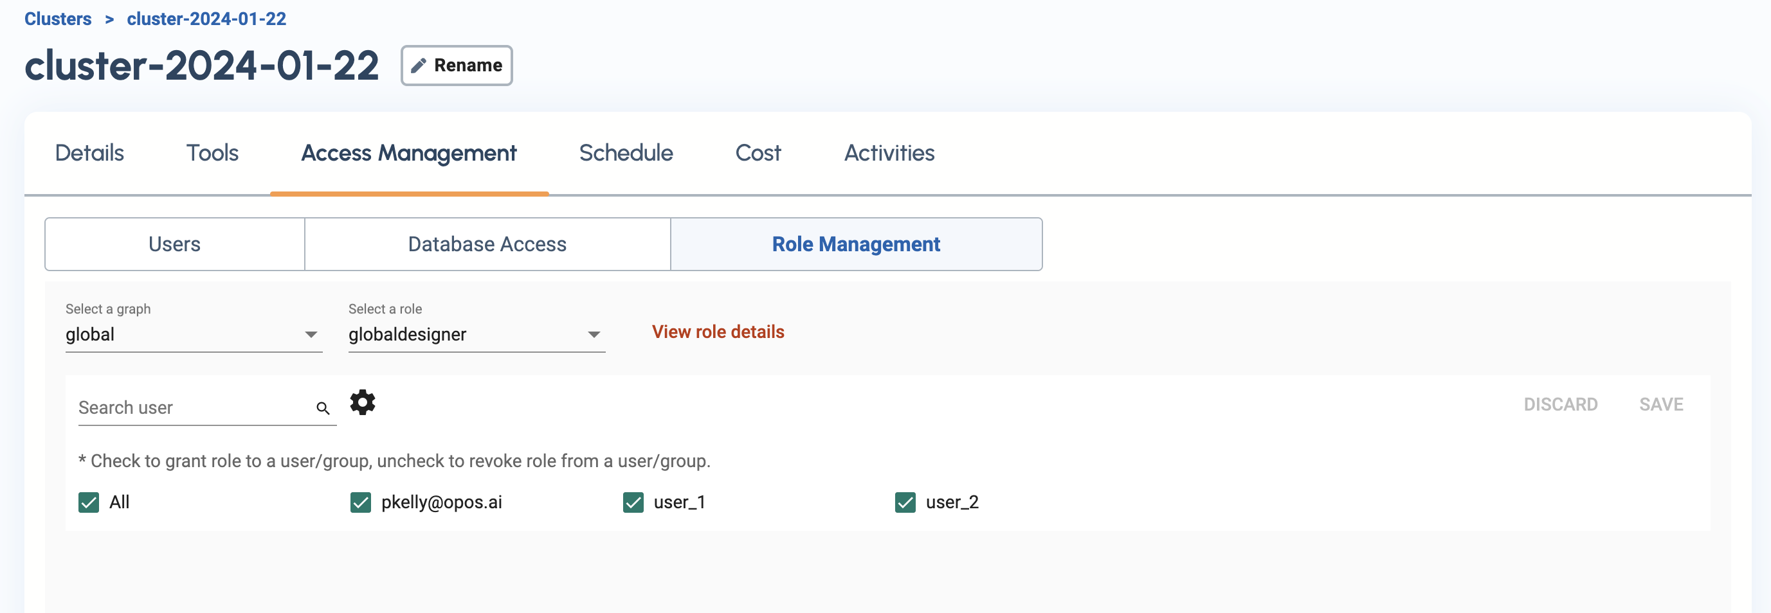
Grant roles to users

Slide 20
Cases
If the previous billing amount was 0 and the current billing amount was 0. There was no account activity
If else the current billing amount is 0, the customer is paid duly

Slide 21
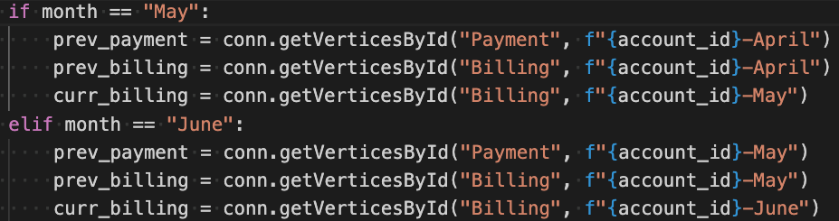
How do we get the previous values?

Slide 22
Unpacking the data to get our value
If we:
We get this data in the terminal
0th index of the list
Accessing the attributes dict
Accessing bill amount value within the dict
==

Slide 23
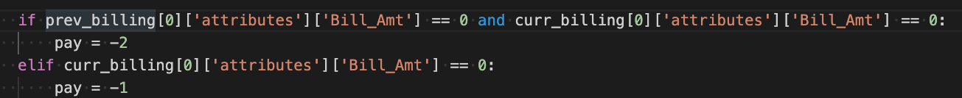
With those values, we can run calculations

Slide 24
Task
Develop an event system to track the development of your data through time.
Create Event Vertex and Edges in TigerGraph Schema.
In TigerGraph schema, create a new vertex called event and create an edge to every vertex including itself.
Populate Event data with python to track the interaction of your data entities.
Write a python function to handle populating the database with events as the occur.

Slide 25
Turn In
Python code as PDF
Screenshot image of your graph instance data with events for the first row of data from April to September

Slide 26
Stretch Exercise
Develop a system to check if the data being uploaded is correct.
Use getVerticesById() to get the past values that have already been populated in the database. With those values, calculate to verify the newest data you are uploading is correct.
Use getVerticesById() to get the values from past months billing and payment.
Use the values from past months to verify the value you are uploading for the current month.

